Slide 1

National Integrated Services Framework
Peter Connolly

Slide 2
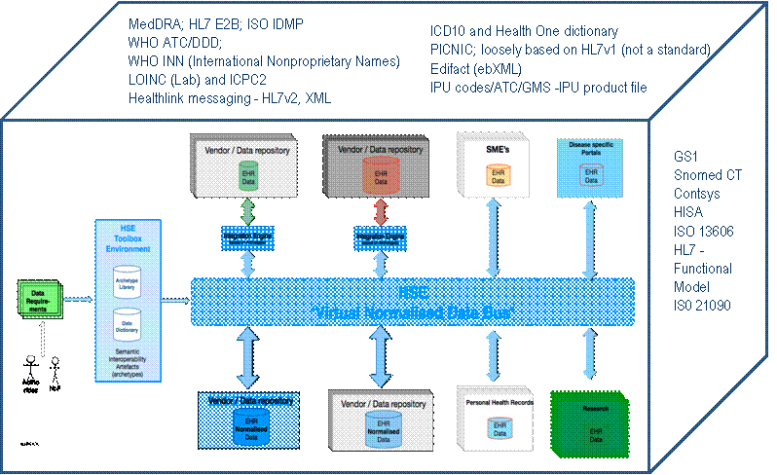
Information Architecture Reference Model (IA-RM)

Slide 3
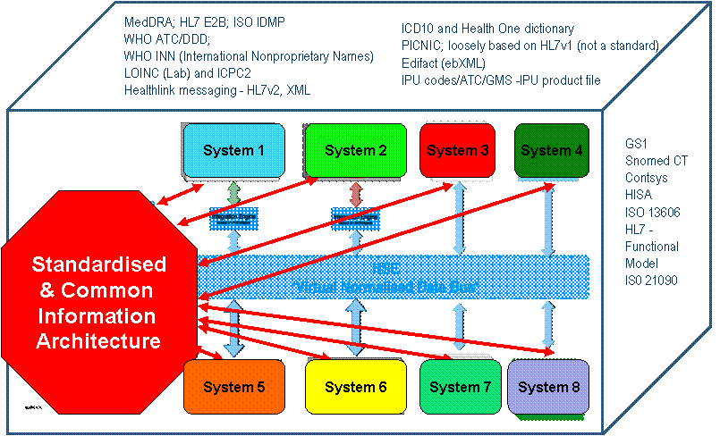
Information Architecture Reference Model (IA-RM)

Slide 4
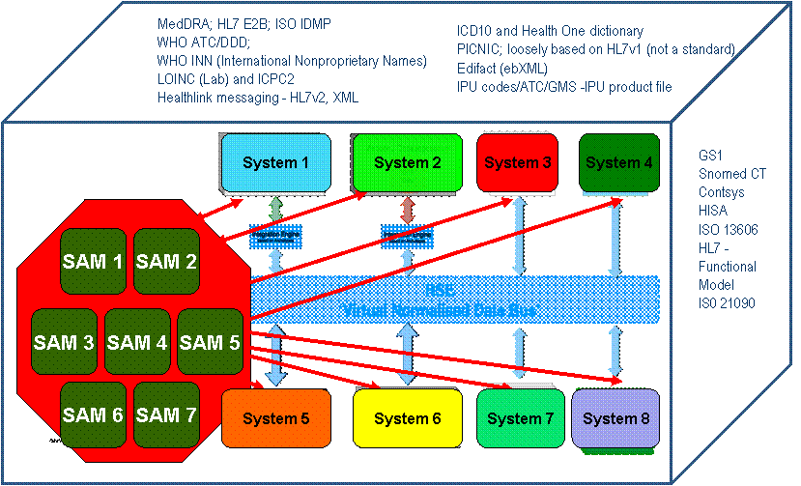
Information Architecture Reference Model (IA-RM)

Slide 5
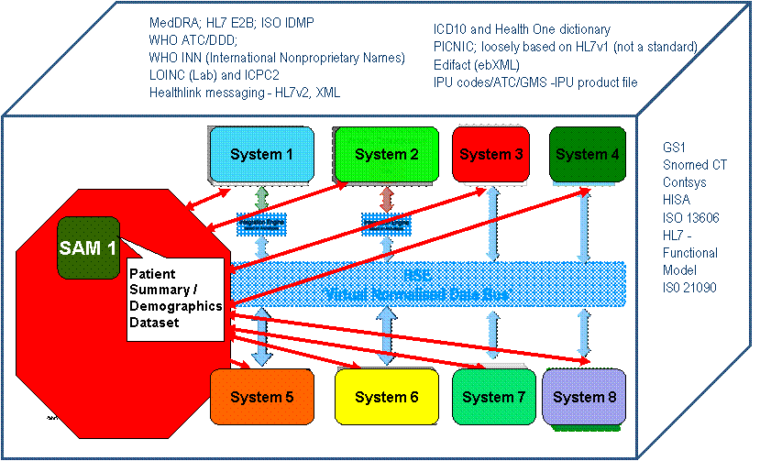
Information Architecture Reference Model (IA-RM)

Slide 6
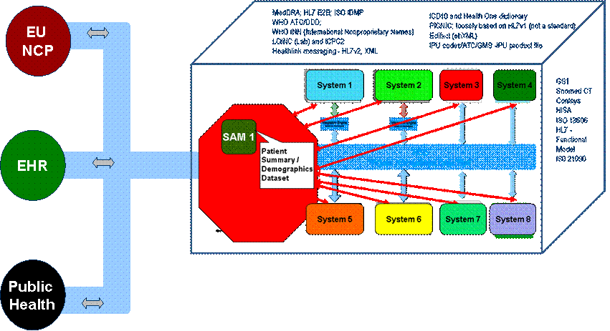
National Information Architecture (IA-RM)

Slide 7
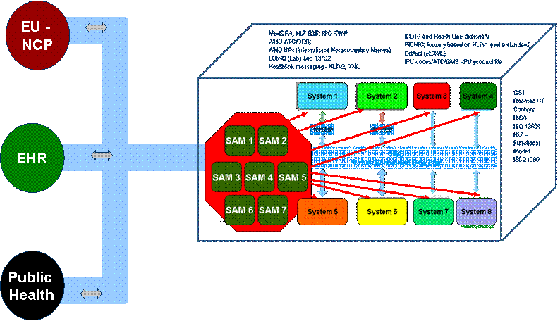
National Information Architecture (IA-RM)

Slide 8
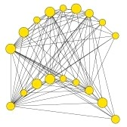
Example Case – Child Health System Information Challenge
NICIS will be used to capture all immunisation events including national childhood immunisation programmes (including schools), outbreaks, campaigns, late entrants, adult vaccinations and pandemic response. In addition the system should allow for the recording of client information relating to neonatal and metabolic screening, breast feeding and developmentals.
The NICIS system will require data sharing with;
The Maternal and Newborn Clinical Management System (MN-CMS) (and prior to that being in place to the Dublin Maternity Hospitals
The National Client Identity Services
Health Service Provider
GP practice management systems
National Cold Chain Delivery System
Primary Care Reimbursement Services (PCRS)
National Cancer Service
The National Childcare System
Department of Social and Family Affairs
The National Newborn Bloodspot Screening
Laboratory (NNBSL),
Universal Neonatal Hearing Screening (UNHS)

Slide 9
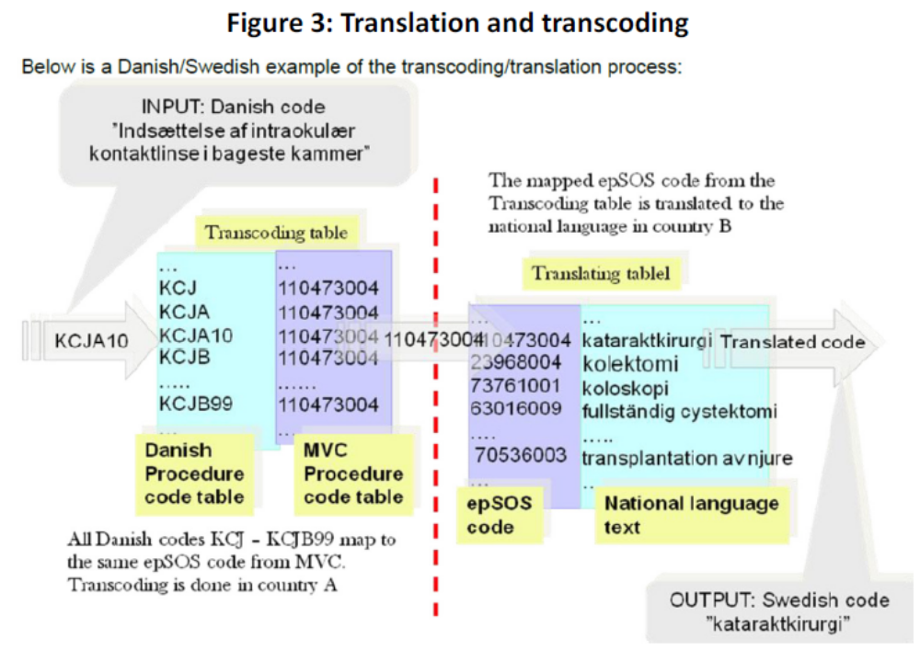
ISF and European Directive

Slide 10
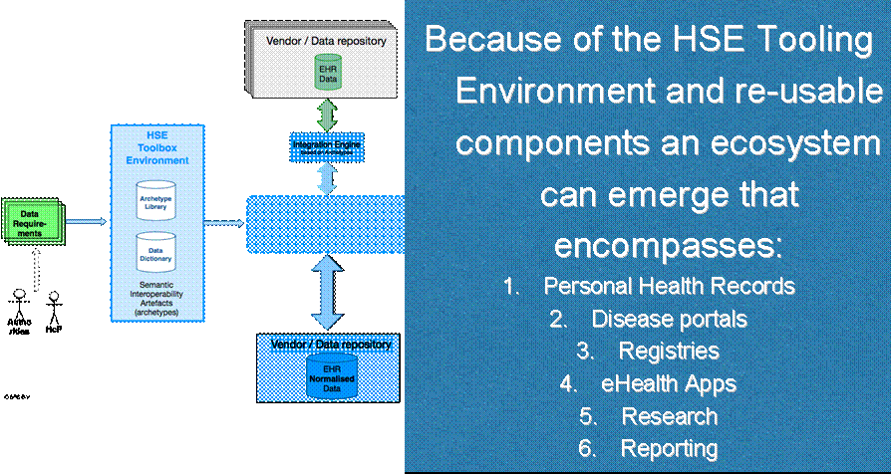
Benefits
Technical Architecture
Notes:
Since data is standardised and structured more will be enabled and become possible.
An ECOSYSTEM can arise because small companies can start to provide new innovative services, or
clinical research can be integrated into existing systems, or
Healthcare providers can start to submit structured and standardised data to authorities.
As can be seen in this slide.

Slide 11
Deployment Option 1
(Solution based around iSOFT/ PAS Subject of Care Identification)
Using Demographics SAM as developed for epSOS Patient Summary
Step 1: Mapping of demographic data from iSoft/PAS to Demographics SAM as foundation
Step 2: Validation by trial integration of data from iSoft / PAS to LIMS-systems and MedLis
Ballpark costs: 5K Euro; duration 2 weeks
Next step: Create SAM for Order Communication
Repeat in SOA deployment to enable early HER capabilities

Slide 12
Questions

